Slide 1


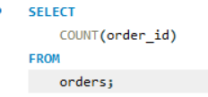

1) Retrieve the total number of orders placed.

Slide 2
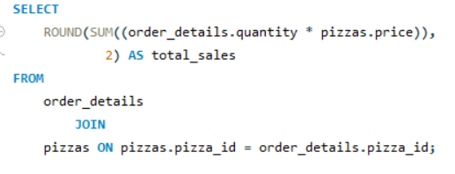

2) Calculate the total revenue generated from pizza sales.

Slide 3
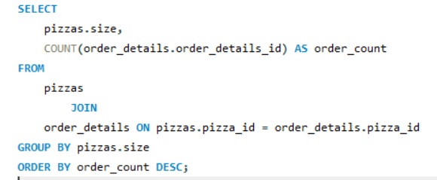
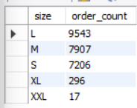
3) Identify the most common pizza size ordered.

Slide 4
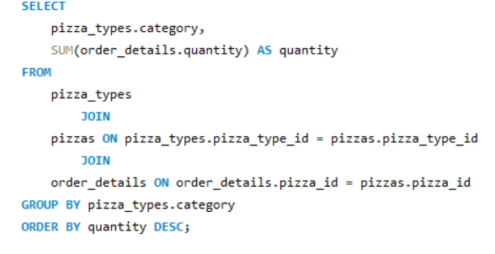
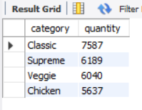
4) Join the necessary tables to find the total quantity of each pizza category ordered.

Slide 5
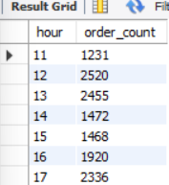
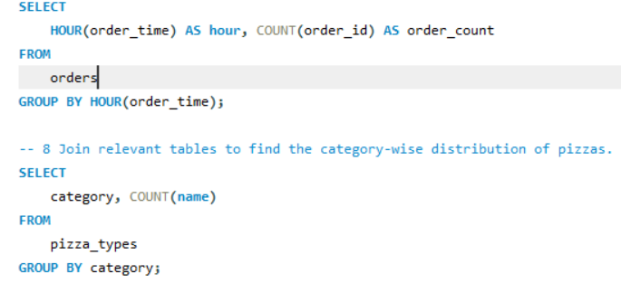
5) Determine the distribution of orders by hour of the day.

Slide 6
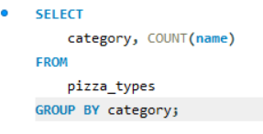
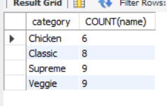
6) Join relevant tables to find the category-wise distribution of pizzas.

Slide 7
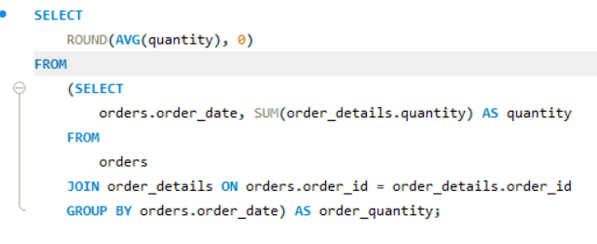
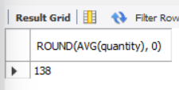
7) Group the orders by date and calculate the average number of pizzas ordered per day.

Slide 8
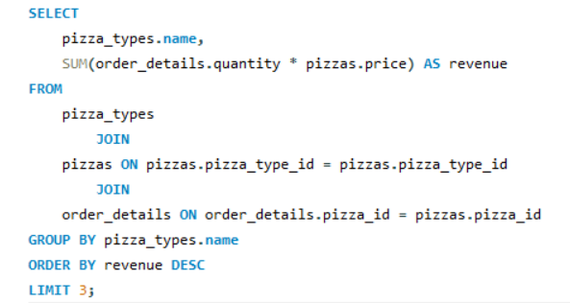
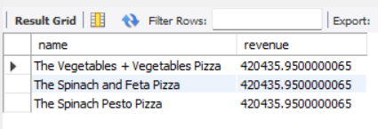
8) Determine the top 3 most ordered pizza types based on revenue.

Slide 9
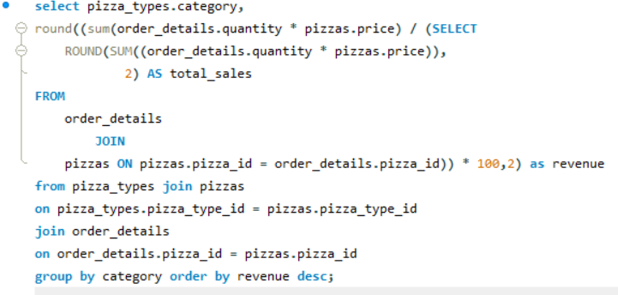
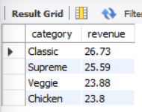
9) Calculate the percentage contribution of each pizza type to total revenue.

Slide 10
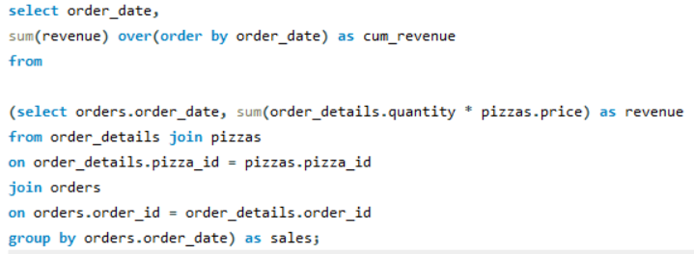
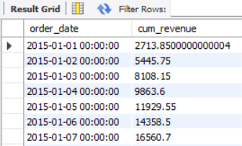
10) Analyze the cumulative revenue generated over time.

